Slide 1
Data Analysis using SQL
-By Atharva More
#16760

Slide 2
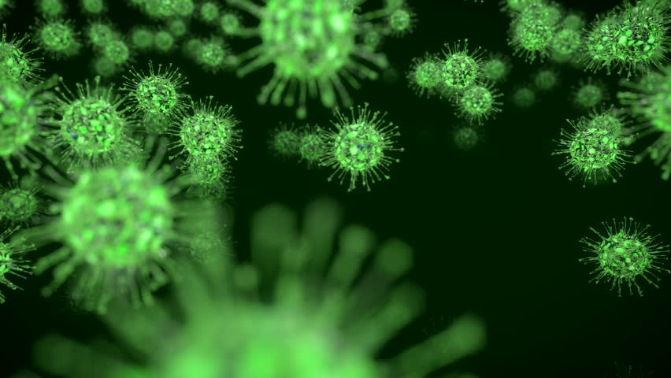
Understanding Dataset
An Air Quality Index(AQI) is a scale used to show how polluted the air is, along with the risks associated with each rating. An AQI is calculated using established standards based on medical research for the acceptable levels of major air pollutants.

Slide 3

Types of Pollutants
PM10/2.5 (Particulate Matter 10/2.5)
O3 (Ozone)
CO (Carbon Monoxide)
SO2 (Sulfur Dioxide)
NO2 (Nitrogen Dioxide)
This Photo by Unknown Author is licensed under CC BY-SA

Slide 4

Variables affecting AQI results
High Temperatures
High Humidity
Wind Speed

Slide 5

What does AQI measurement do?
Good (0-50 AQI): 0-54 µg/m³
Moderate (51-100 AQI): 55-154 µg/m³
Unhealthy for Sensitive Groups (101-150 AQI): 155-254 µg/m³
Unhealthy (151-200 AQI): 255-354 µg/m³
Very Unhealthy (201-300 AQI): 355-424 µg/m³
Hazardous (301-500 AQI): 425+ µg/m³

Slide 6
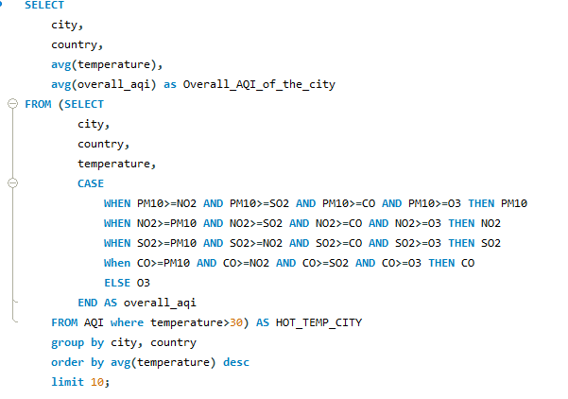
AQI of top 10 cities with hot weather (excluding PM2.5)

Slide 7
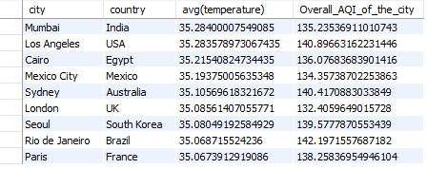

Slide 8
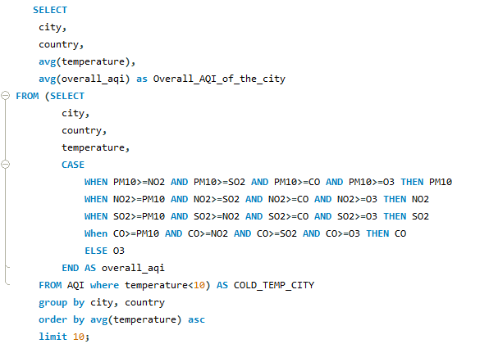
AQI of top 10 cities with cold weather (excluding PM2.5)

Slide 9
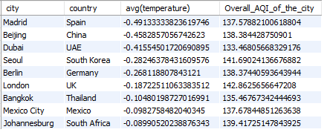

Slide 10

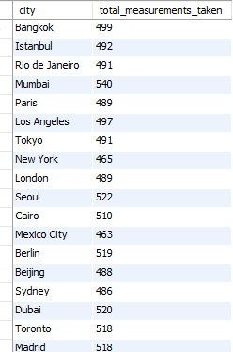
Total Measurements taken for every city

Slide 11
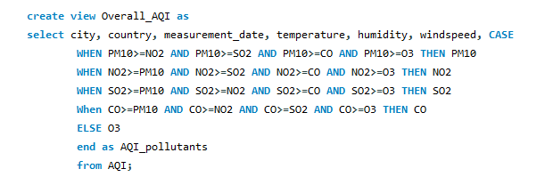

Slide 12
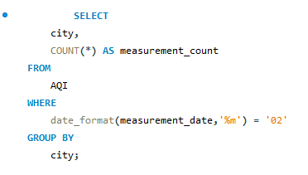
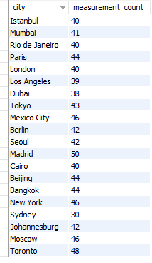
Total Measurements taken for every city during February

Slide 13
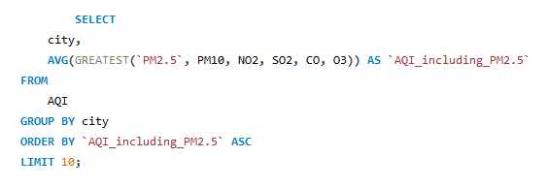
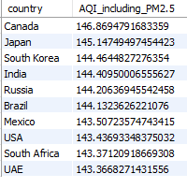
Top 10 countries with highest AQI (All pollutants included)

Slide 14

Thank You

